Slide 1
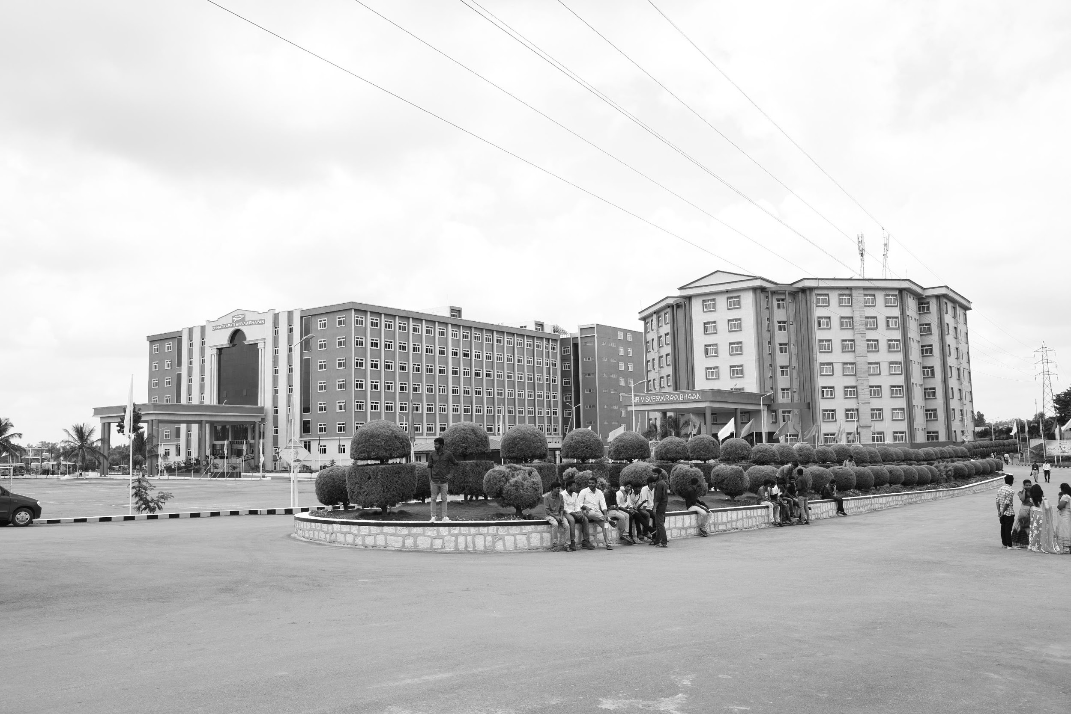

GRAPHIC ART INDUSTRIES
AY 2021-25
Department of Electrical Electronics and Communication Engineering
PROJ3999
A University should be a place of light, of liberty, and of learning
GITAM UNIVERSITY
By
SUHAS S
Project mentor
Dr. Rohan prasad

Slide 2

Student Details

Slide 3
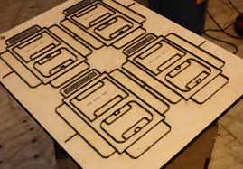
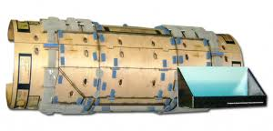
Agenda
Introduction
Printing Types
Process of Printing
Introduction to Machines
Objectives and Goals
Challenges in the conventional Die Cutting method
Need for the new Design
Production of new Design
Implementation
Trail runs
Results

Slide 4
Objectives and Goals
SI NO | ACTIVITY | STATUS
1 | Understanding the Process of Printing, Die Cutting and Folding Operations in a Packaging Industry | 
2 | Customer Visits | 
3 | Gaining the knowledge of the process of Die Cutting | 
4 | Challenges in the conventional Die Cutting method (use of 7 MM Counter plate) | 
5 | Need for 6mm + 1 mm Counter plate (Advantages) | 
6 | Design of such a system - Study the part, design the parts | 
7 | Production as per the new design | 
8 | Implementation of the developed design | 
9 | Trial runs | 
10 | Results | 

Slide 5
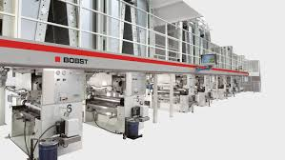
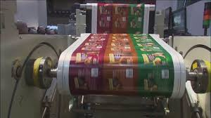
Introduction
Graphic Art Industries
-Printing and Packaging
Graphic art mostly includes calligraphy, photography, painting, typography, computer graphics and bindery
Create many different kinds of projects such as Book covers, Still or moving images and storyboards for film or television.

Slide 6

Printing Types
Commercial / Packaging Printing
Commercial printing is the process of using large-format printing machines to create high-quality printed materials.
This includes business cards, flyers, banners, posters, catalogs, magazines and more.
Types of commercial printing
Digital Printing
Screen Printing
LED UV Printing
Offset Printing
Flexographic Printing

Slide 7
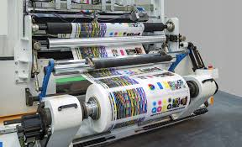

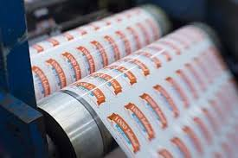
Packaging Printing
Package printing is the process of applying images to packaging materials. There are several printing methods used for packaging, including digital, flexographic, offset, gravure and screen printing.
Offset printing
A widely used method that uses wet ink and printing plates to create high-quality materials.

Slide 8
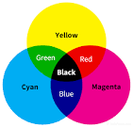
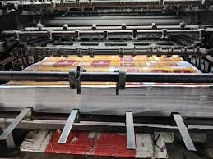
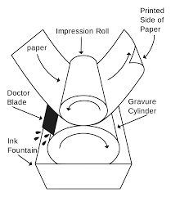
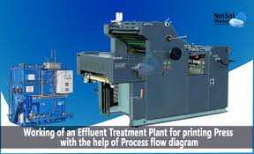
Process of Printing
Pre-press
Computer-to-Plate
Press
CYMK
4C,5C,6C,
Post-press
Loop lamination
Die- cutting
Folder-gluer(paste)
foil stamping
Cyan, magenta, yellow, black

Slide 9
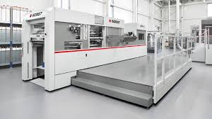
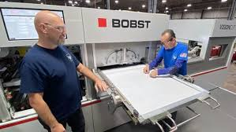
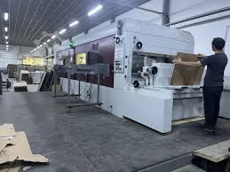
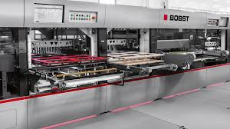
Introduction to Die Cutting Machines
The current work deals with BOBST company machines.
Configurations
NOVACUT 106 | 8000 S/H
VISION CUT | 8000 S/H
EXPERT CUT | 9000 S/H
MASTER CUT | 1200S/H

Slide 10
Challenges in the conventional Die Cutting method
The Punching bed is equipped with 7 mm thick support plate (Counter Plate)
Each Job is to be prepared on this Counter Plate
This requires a dedicated Counter plate for each job
One needs to have as many number of plates as the number of jobs
The size of the counter plate varies from 1020 mm X 760mm to 1080 mmX760 mm
This makes the plates heavy for quick job changeovers and handling
Any damage caused during handling and changeover needs a replacement of the whole plate
The replacement cost is huge considering the size and weight of the plate

Slide 11
Need for 6mm + 1 mm Counter plate
The 6 mm plate acts as permanent fixture to the bed of the machine
The bed needs to be modified to accomodate this change
This 6 mm plate should be of high quality Stainless Steel
Since it will be permanent setup (rarely needs to replaced)
On top of this 6 mm plate provision will be made to fix the 1 mm Plate (Counter plate)
This requires new design of 6 mm Plate and 1 mm Plate
One needs to have only as many number of 1mm plates as the number of jobs
The new design makes the 1 mm counter plates light for quick job changeovers and handling
Any damage caused during handliung and changeover needs a replacement of the only 1 mm plate
The replacement cost will be considerably low compared to previous design

Slide 12
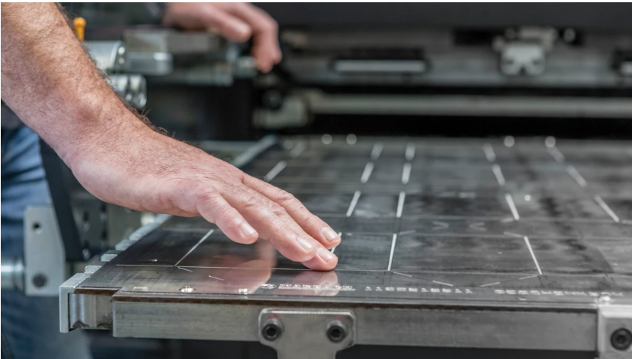
Study and design of the parts
A Visit to the customer Location
Understanding the job preparation and handling of the 5 mm Plates
Collection of the sample

Slide 13
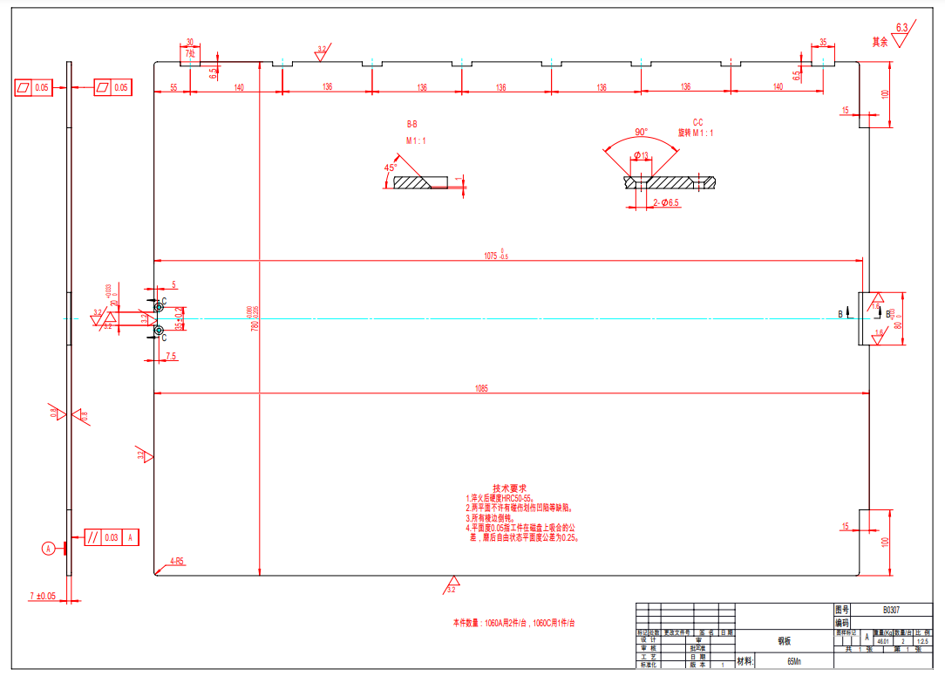
Study and design of the parts
Analysing the drawings provided by the customer

Slide 14
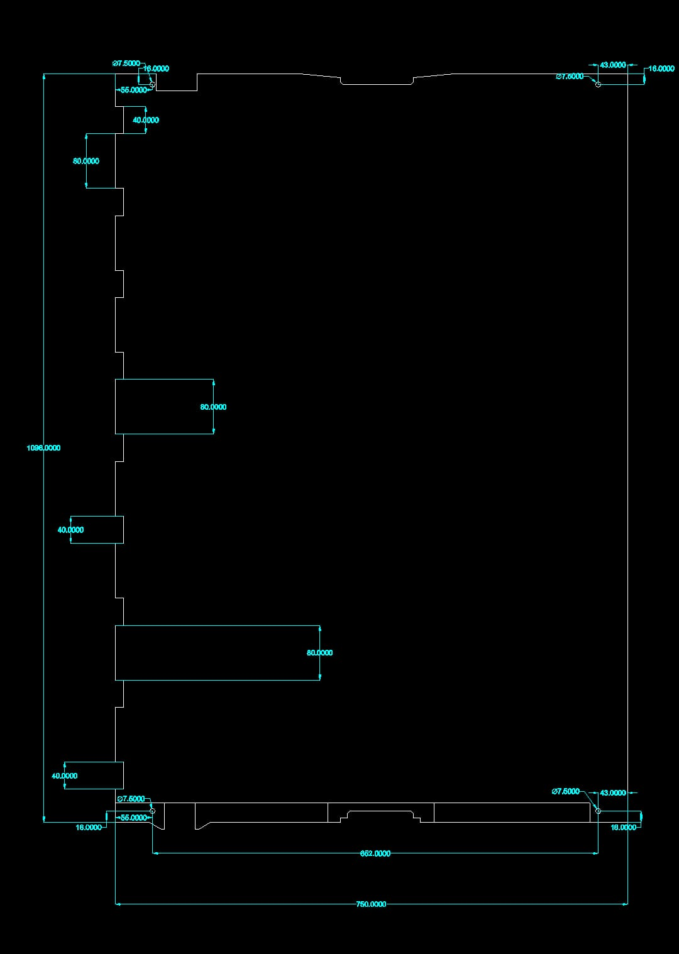
Study and design of the parts
Developing the new design for 6 mm Base plate

Slide 15
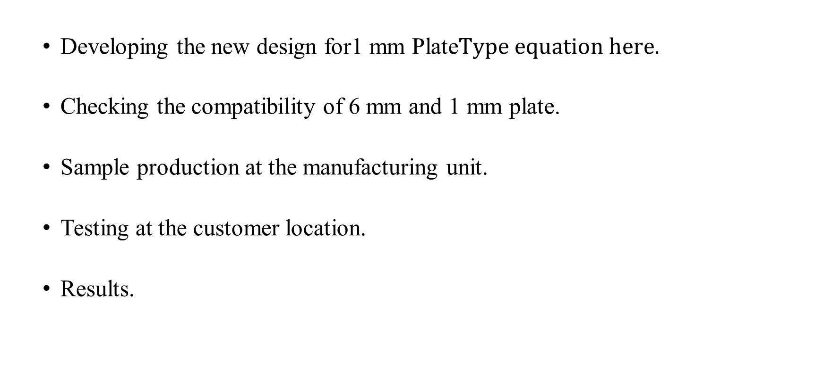
Study and design of the parts (to be done)
Developing the new design for1 mm Plate
Checking the compatibility of 6 mm and 1 mm plate.
Sample production at the manufacturing unit.
Testing at the customer location.
Results.

Slide 16
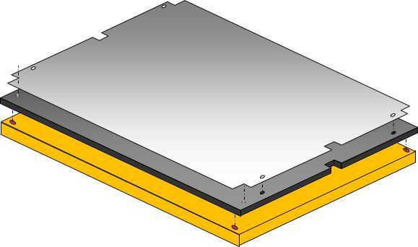
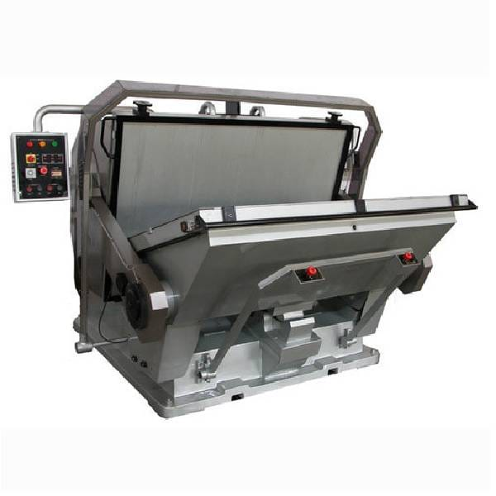
Sample production and mounting
Convert 7 mm to 6+1 mm
Mounting the 6 mm sheet on the bed
Mounting 1 mm sheet on 6 mm sheet without disturbing Functionality
6 mm sheet is mostly permanent and 1 mm sheet is replaceable
Each 1 mm sheet is dedicated to One Job

Slide 17
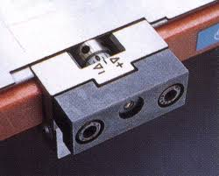
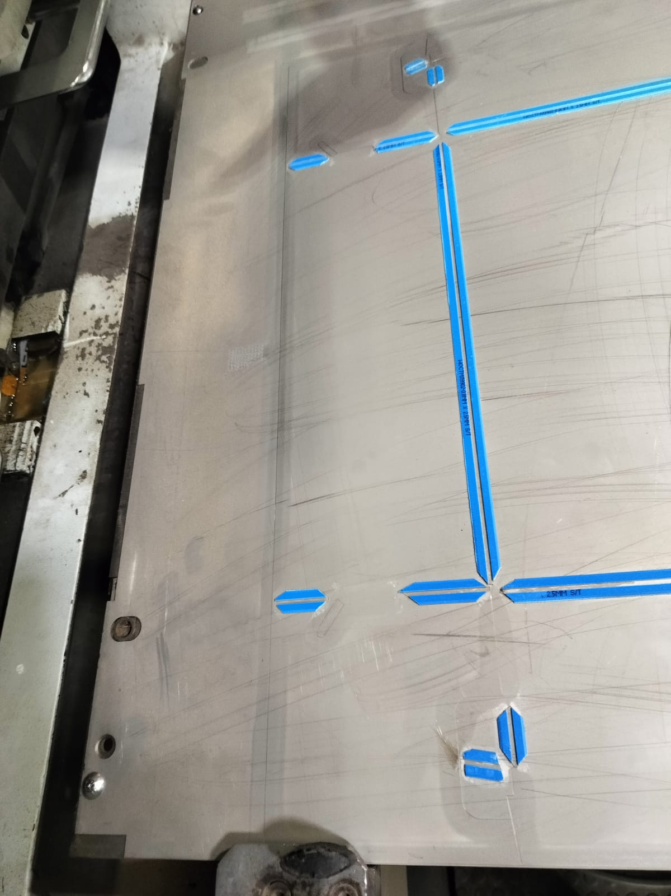
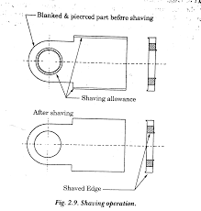
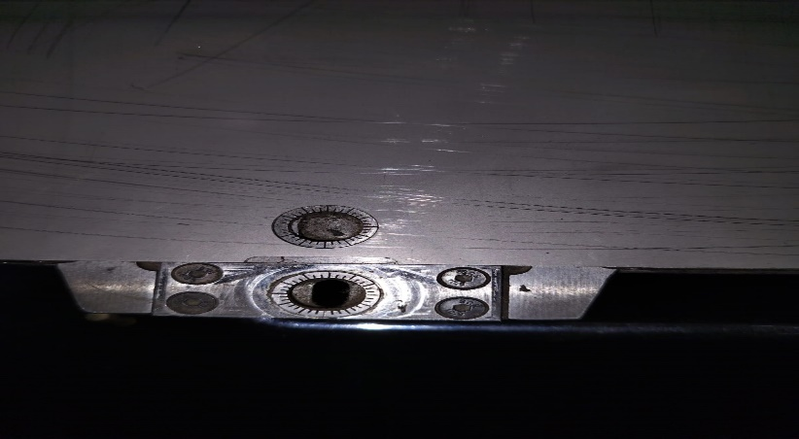
CHALLENGES
Compatibility of the 1MM Plate.
Overall thickness
Fixing of 1 mm Plate to 6 mm plate
Displacement of 1 mm Plate
Design of fixture to avoid the Displacement of 1 mm

Slide 18
RESULT
Knowledge of printing and packaging industry is acquired.
Exclusive study of convectional and current punching machine.
Cost effective method of punching implemented.
Need for the quick job change overs is achieved.
The developed method could be successfully implemented for 4+1mm, 5+1mm or for any similar combinations.

Slide 19
THANK YOU
ID- ssuresh2@gitam.in

